Slide 1
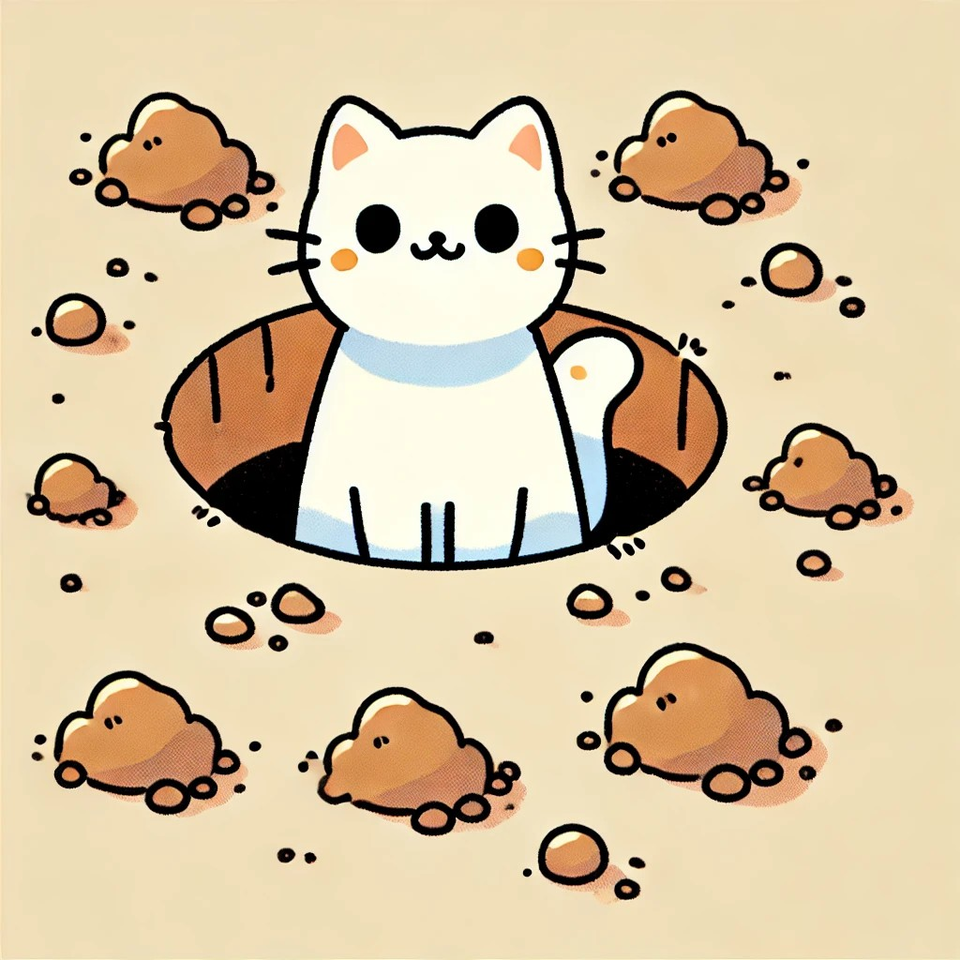
Set 1
The Cat is in the Pit

Slide 2
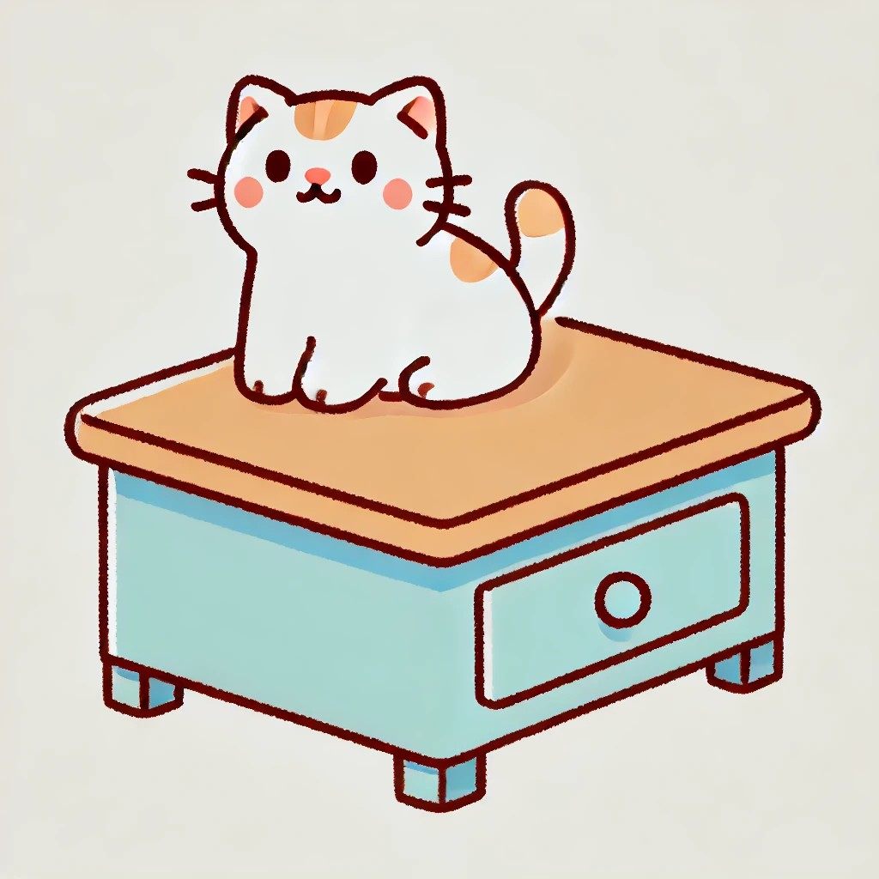
The Cat is on

Slide 3

The Cat is in

Slide 4

The Net is in the Pit

Slide 5

The Net is on

Slide 6

The Net is in

Slide 7
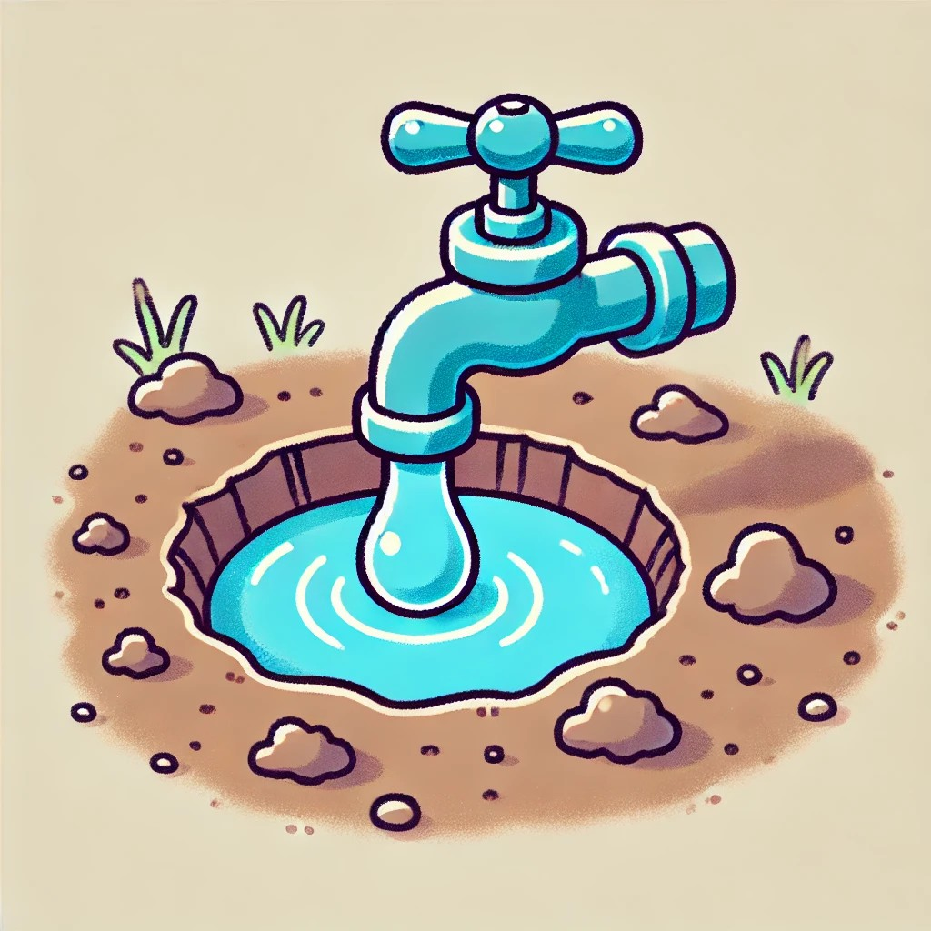
The Tap is in the Pit

Slide 8

The Tap is on

Slide 9

The Tap is in

Slide 10

The Pet is on

Slide 11
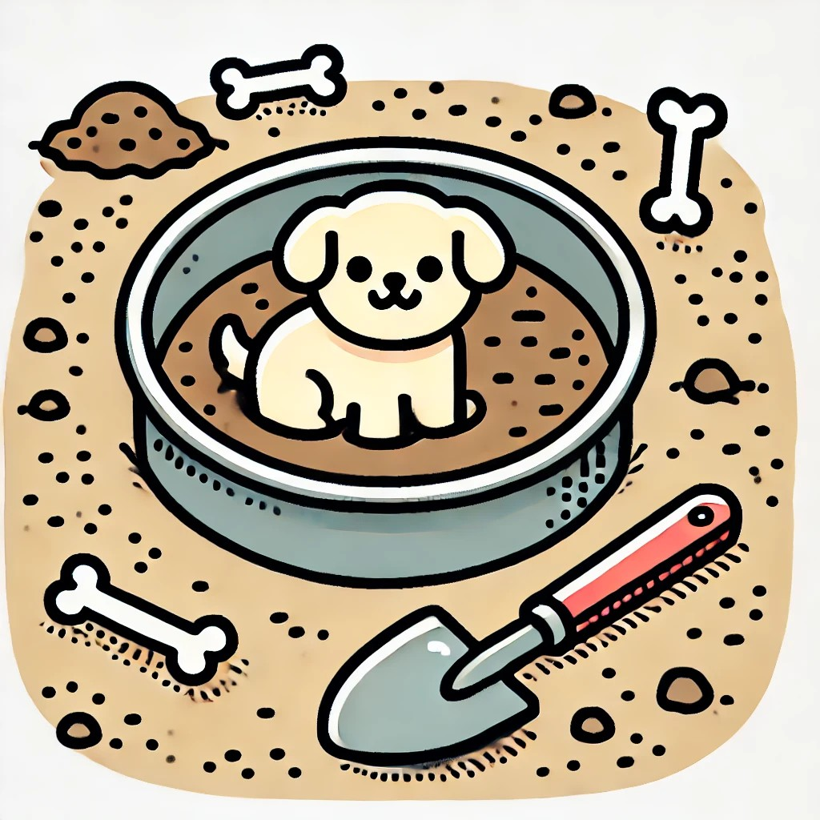
The Pet is in

Slide 12
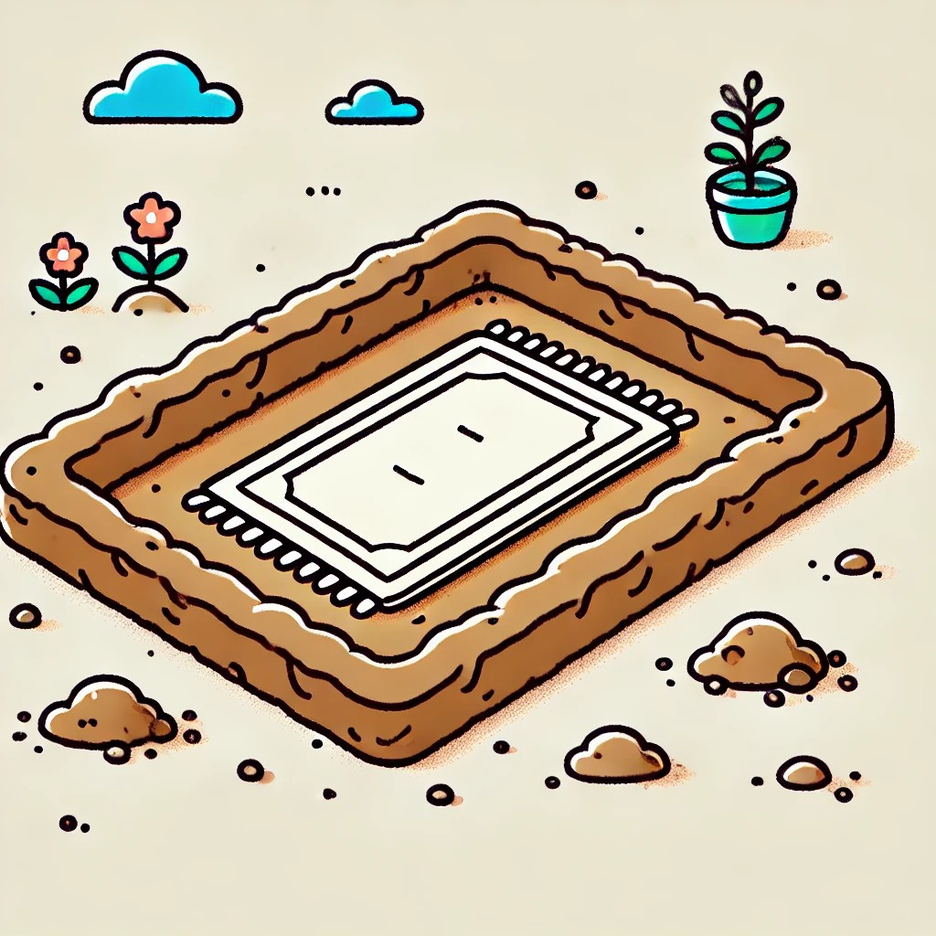
The Mat is in the Pit

Slide 13
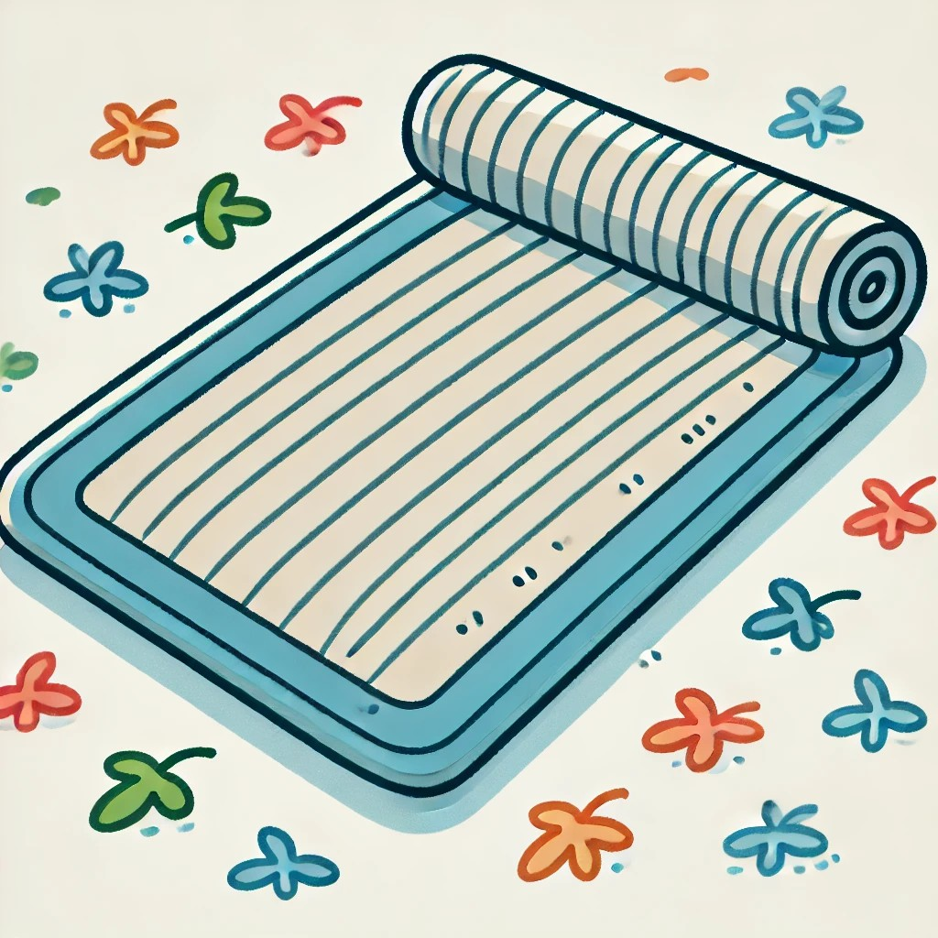
The Mat is on

Slide 14
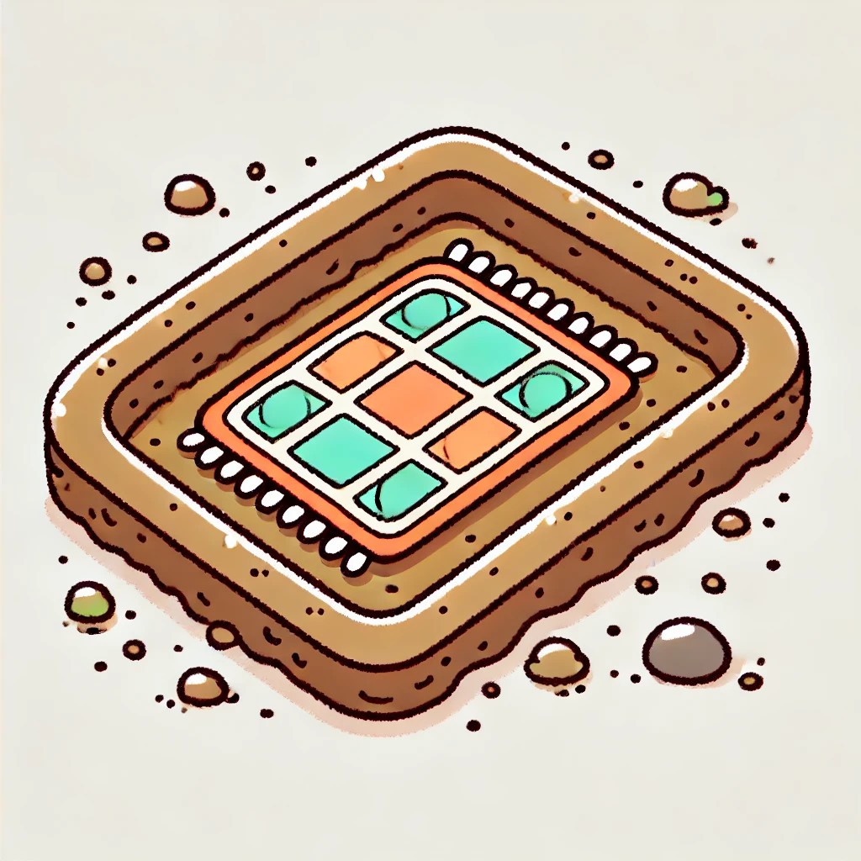
The Mat is in

Slide 15

The Pot is in the Pit

Slide 16

The Pot is on

Slide 17

The Pot is in

Slide 18

The Map is in the Pit

Slide 19

The Map is on

Slide 20

The Map is in

Slide 21
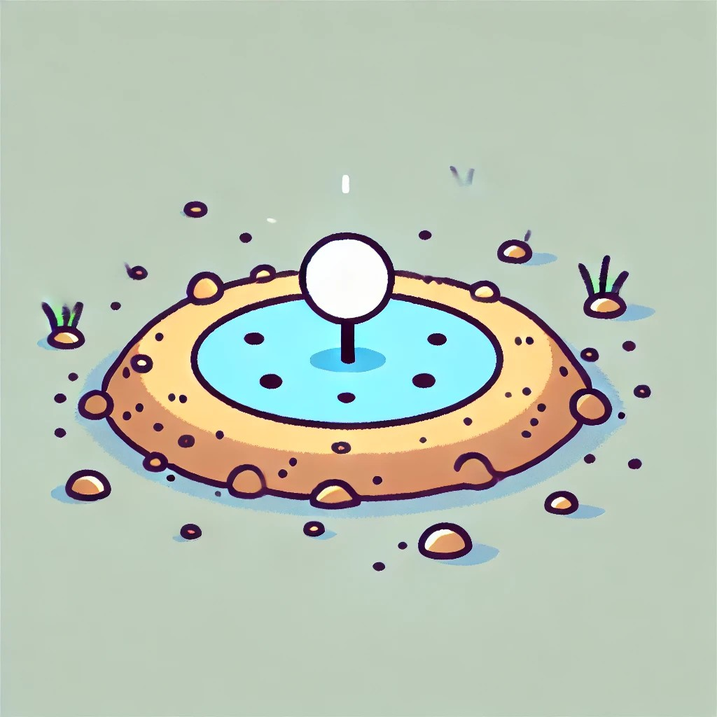
The Dot is in the Pit

Slide 22
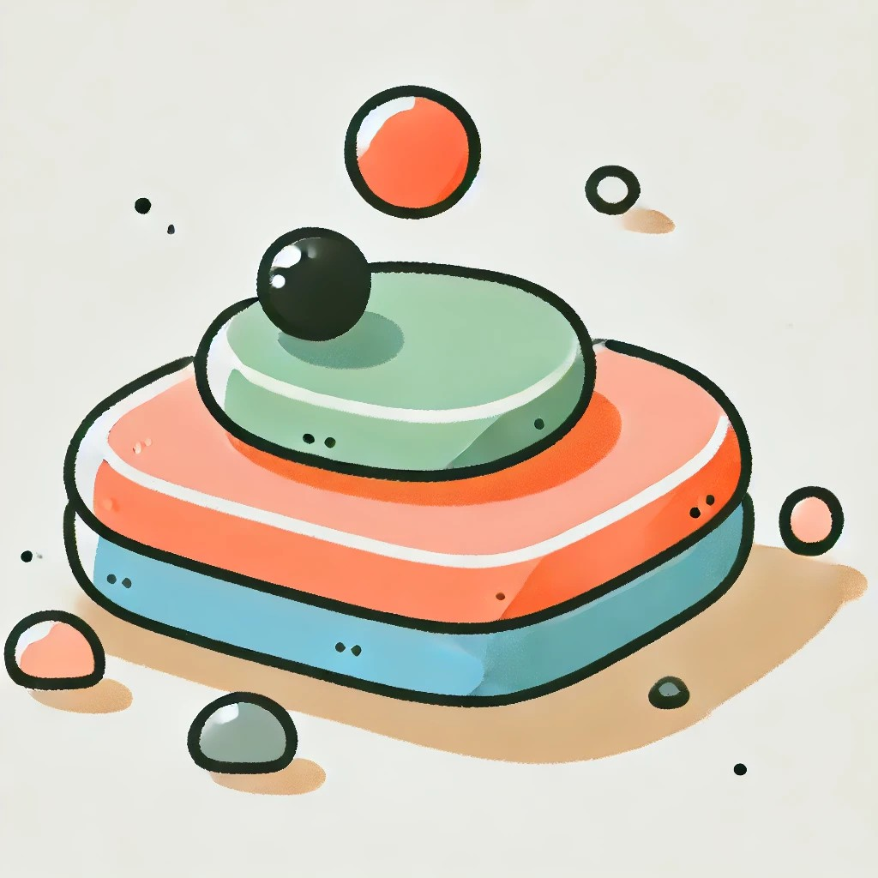
The Dot is on

Slide 23
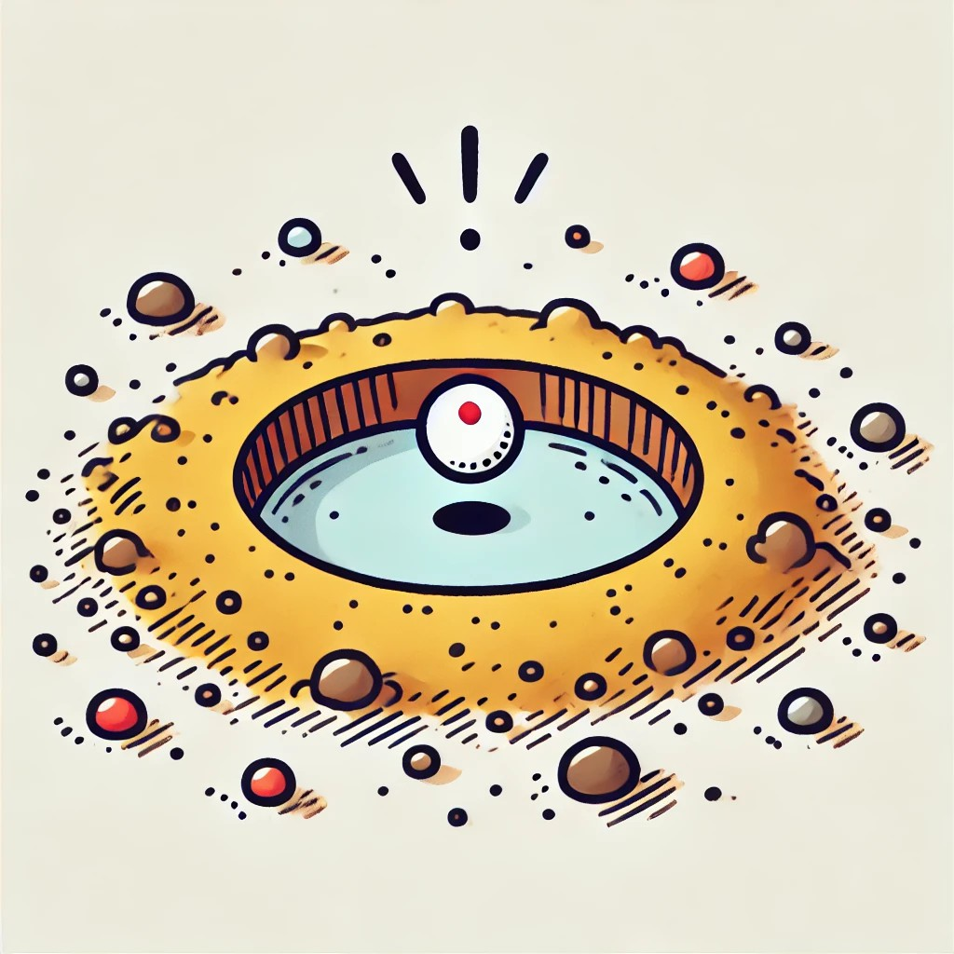
The Dot is in

Slide 24

The Dog is in the Pit

Slide 25

The Dog is on

Slide 26

The Dog is in

Slide 27
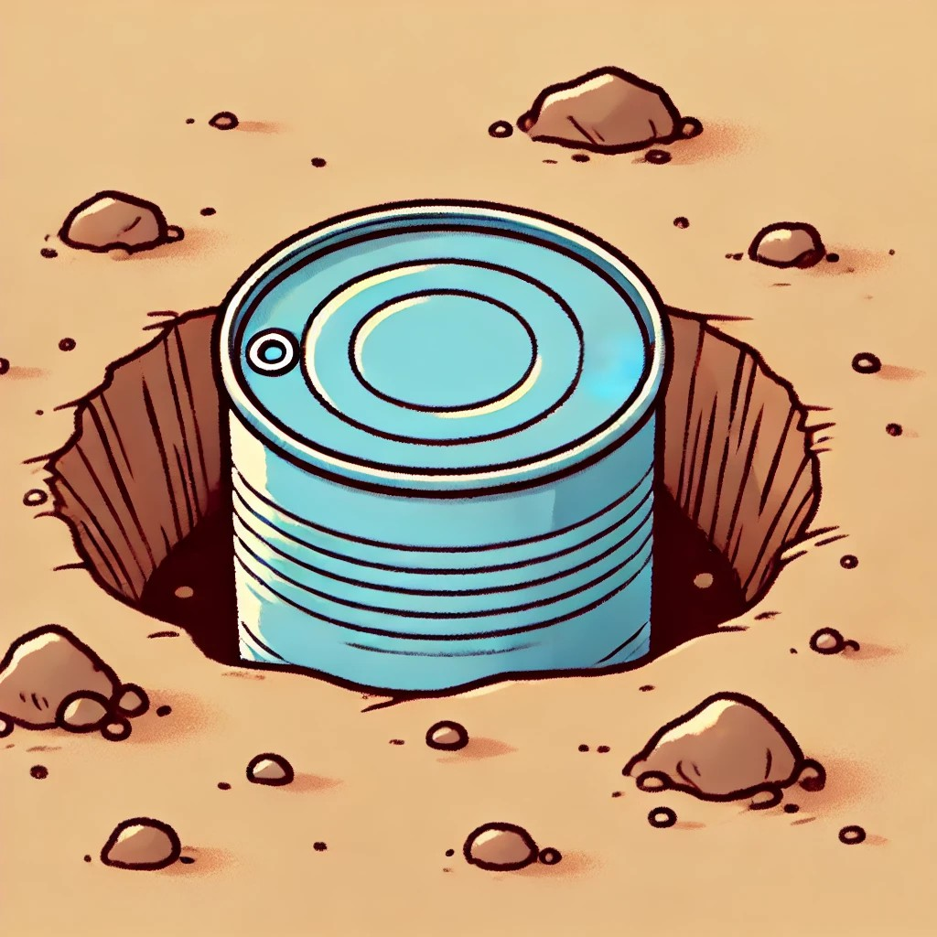
The Tin is in the Pit

Slide 28

The Tin is on

Slide 29

The Tin is in

Slide 30

The Mud is in the pit

Slide 31

The Mud is on

Slide 32

The Mud is in

Slide 33

The Cup is in the Pit

Slide 34

The Cup is on

Slide 35

The Cup is in

Slide 36

The Log is in the Pit

Slide 37

The Log is on

Slide 38

The Log is in

Slide 39
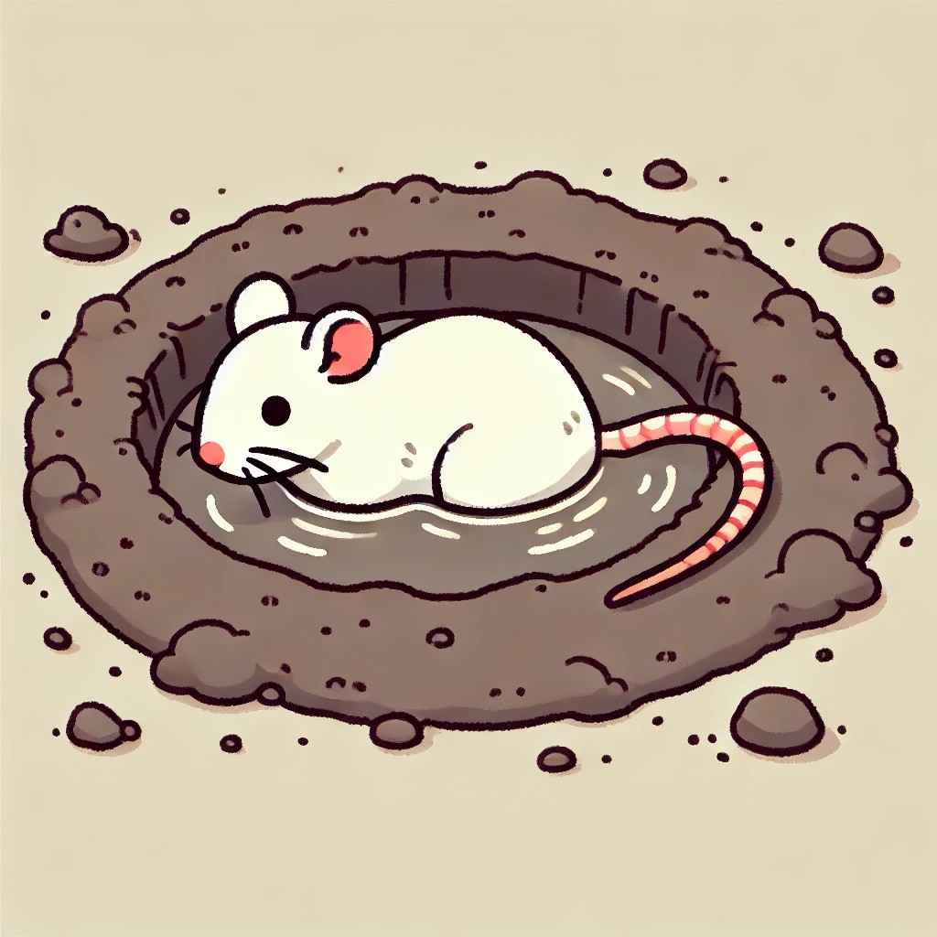
The Rat is in the Pit

Slide 40

The Rat is on

Slide 41
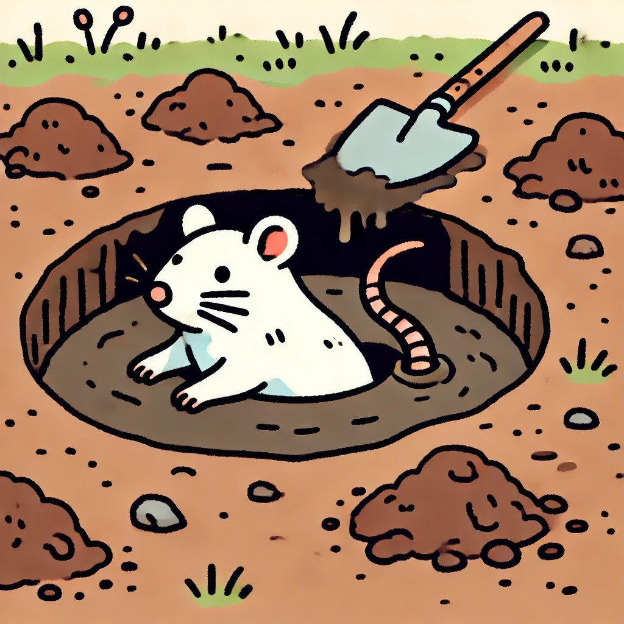
The Rat is in

Slide 42

The Mop is in the pit

Slide 43

The Mop is on

Slide 44

The Mop is in

Slide 45

The Nut is in the pit

Slide 46

The Nut is on

Slide 47

The Nut is in

Slide 48
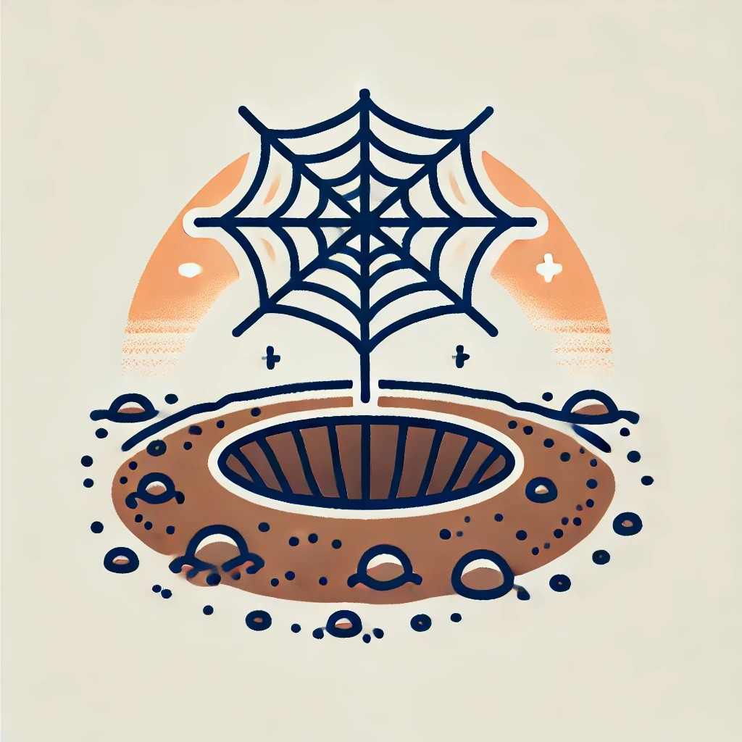
The web is in the pit

Slide 49

The Web is on

Slide 50

The Web is in

Slide 51
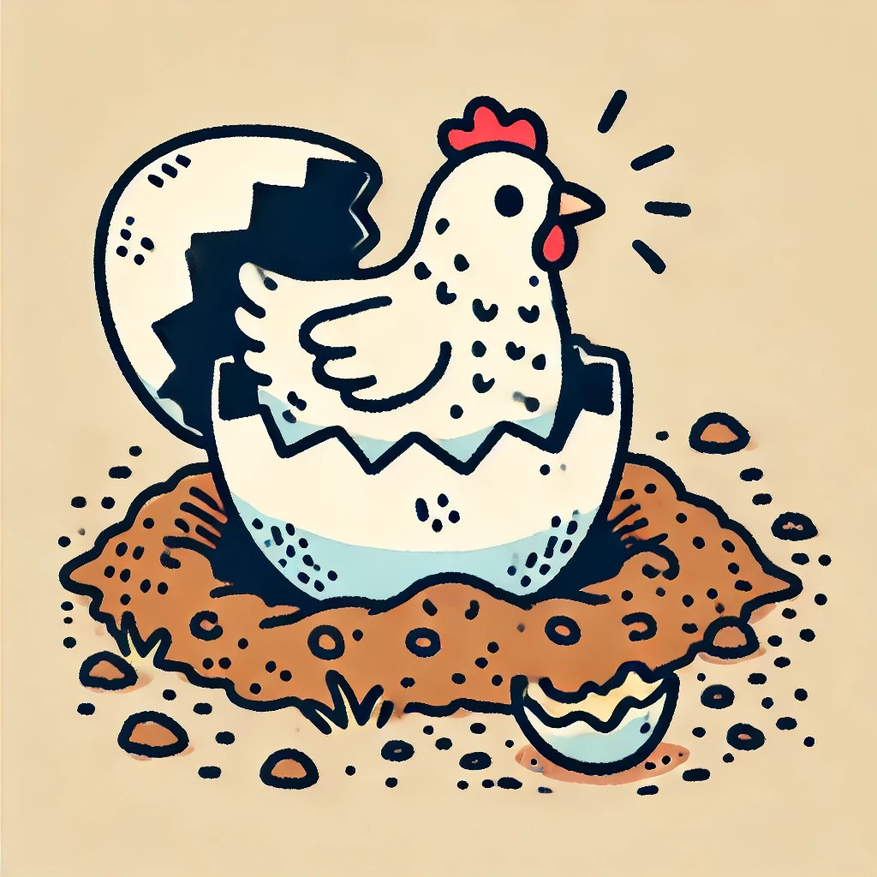
The Hen is in the pit

Slide 52
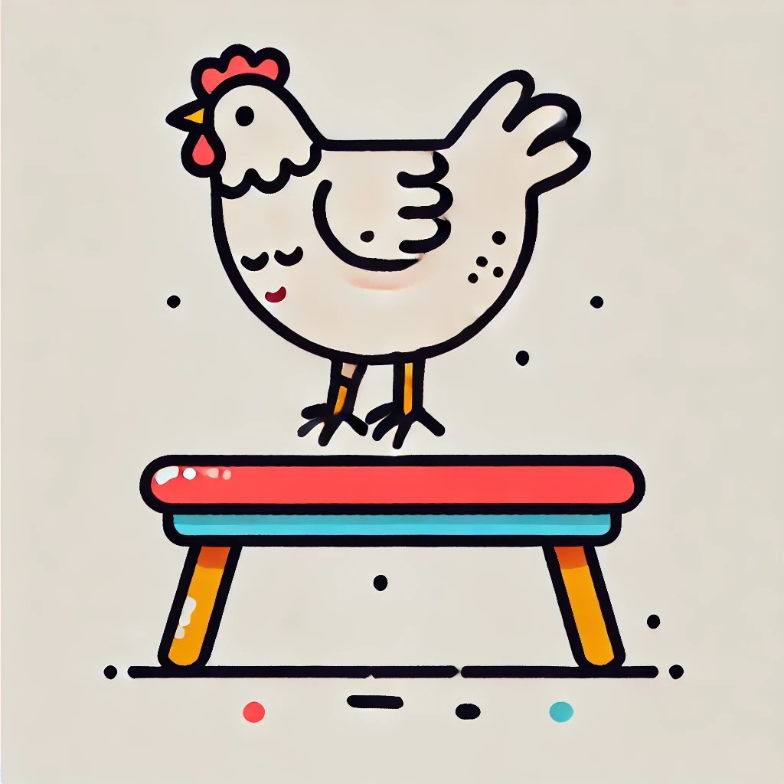
The Hen is on

Slide 53
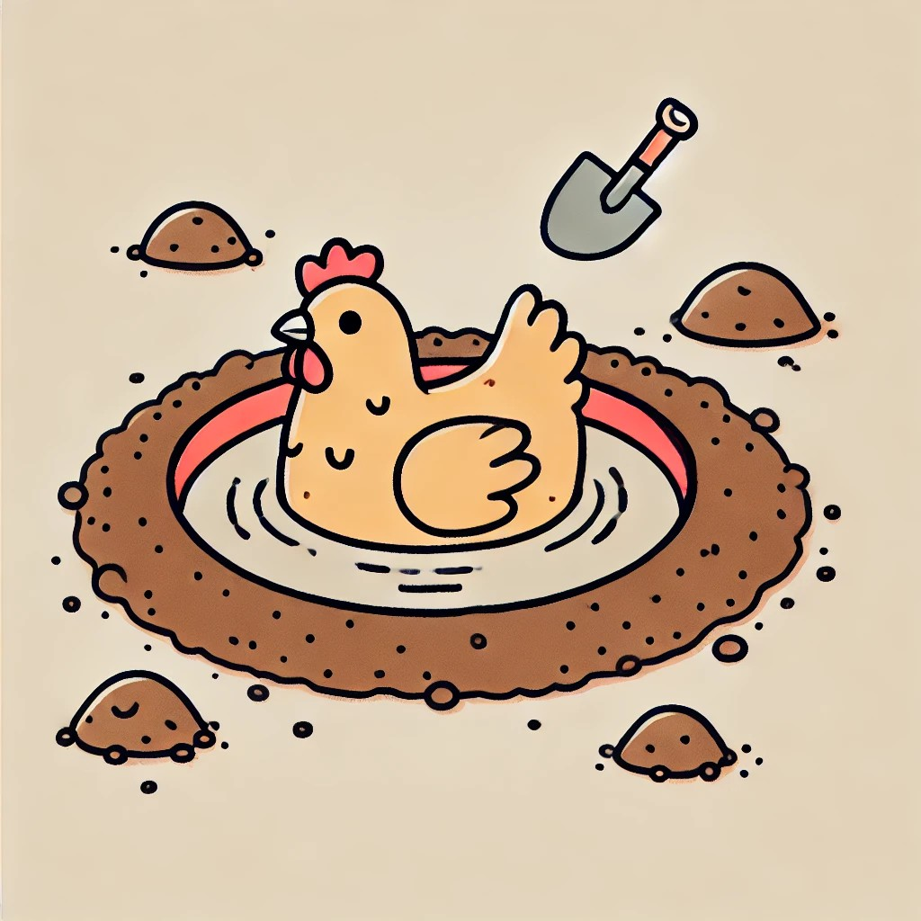
The Hen is in

Slide 54
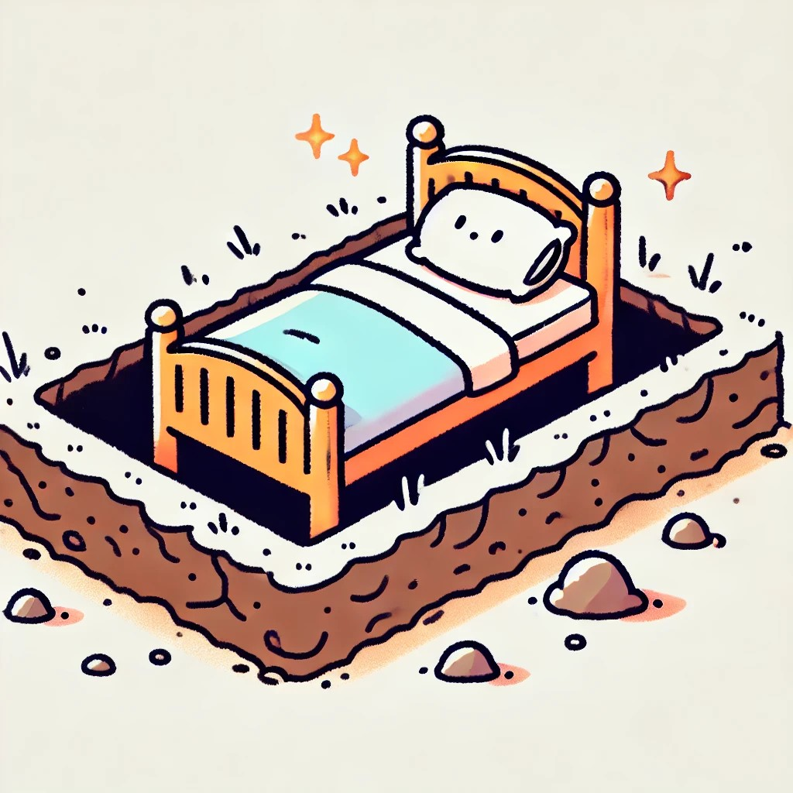
The bed is in the pit

Slide 55

The Bed is on

Slide 56
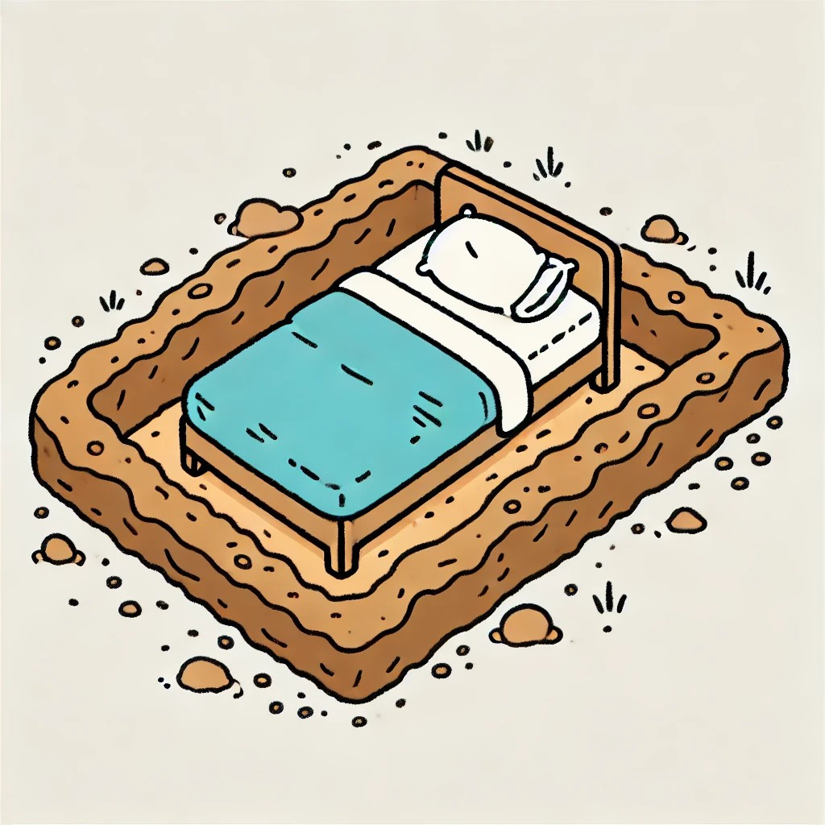
The Bed is in

Slide 57
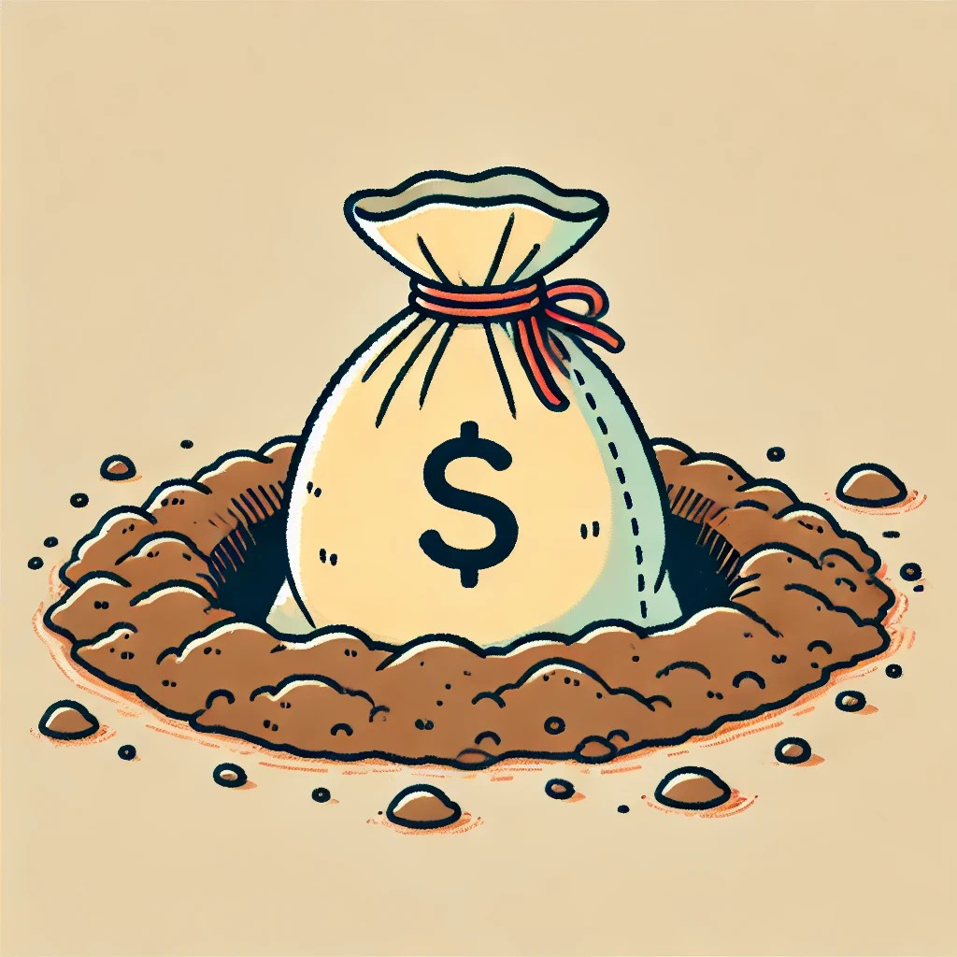
The bag is in the pit

Slide 58

The Bag is on

Slide 59
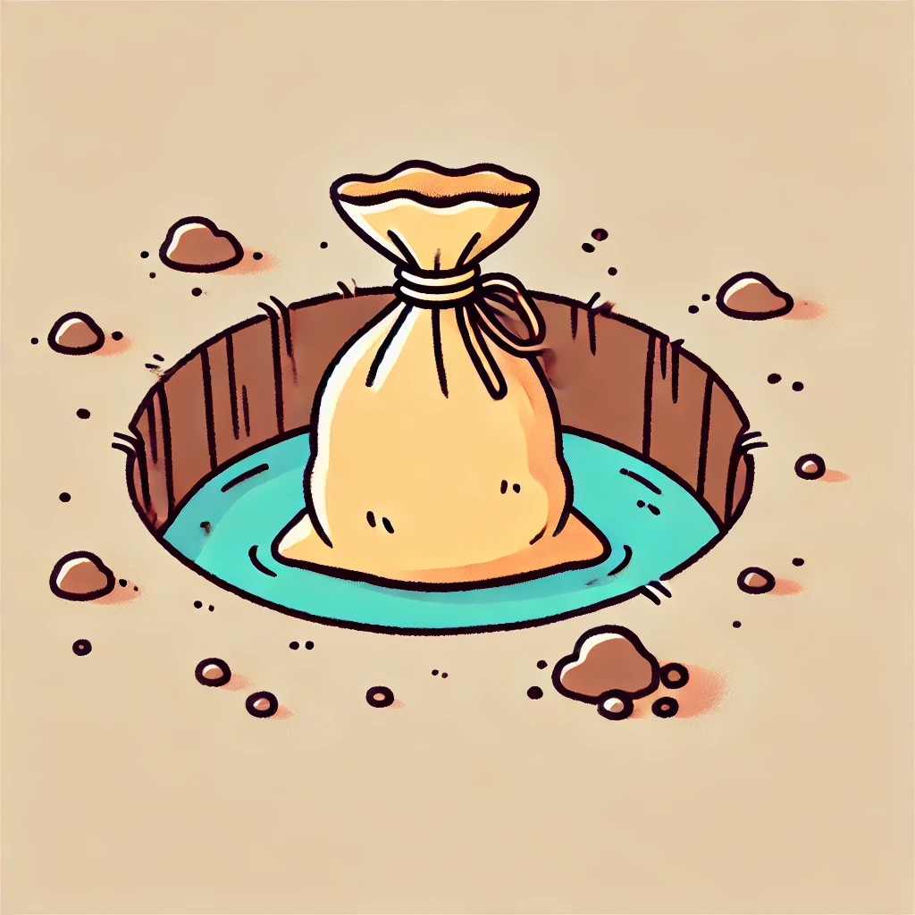
The Bag is in

Slide 60

The Van is in the Pit

Slide 61

The Van is on

Slide 62

The Van is in

Slide 63
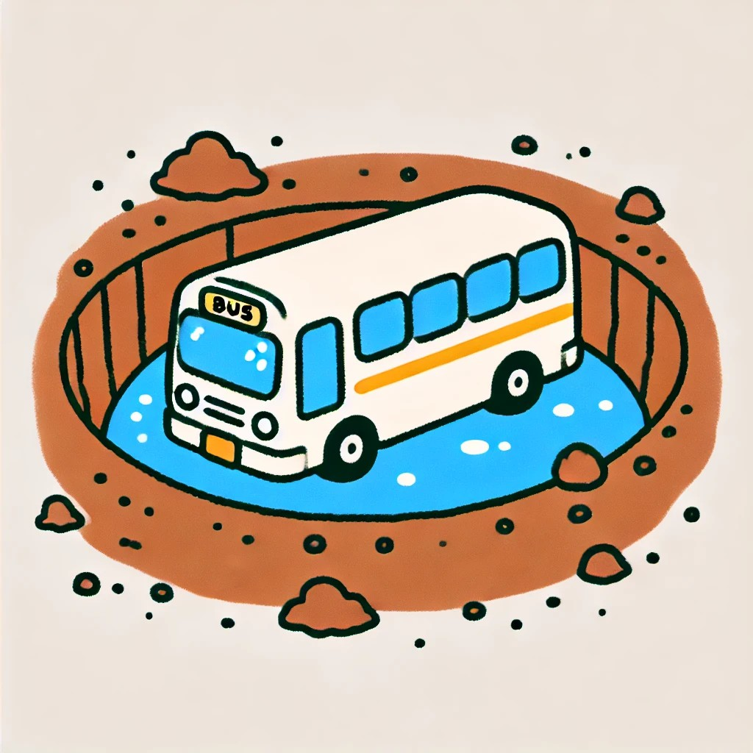
The Bus is in the Pit

Slide 64
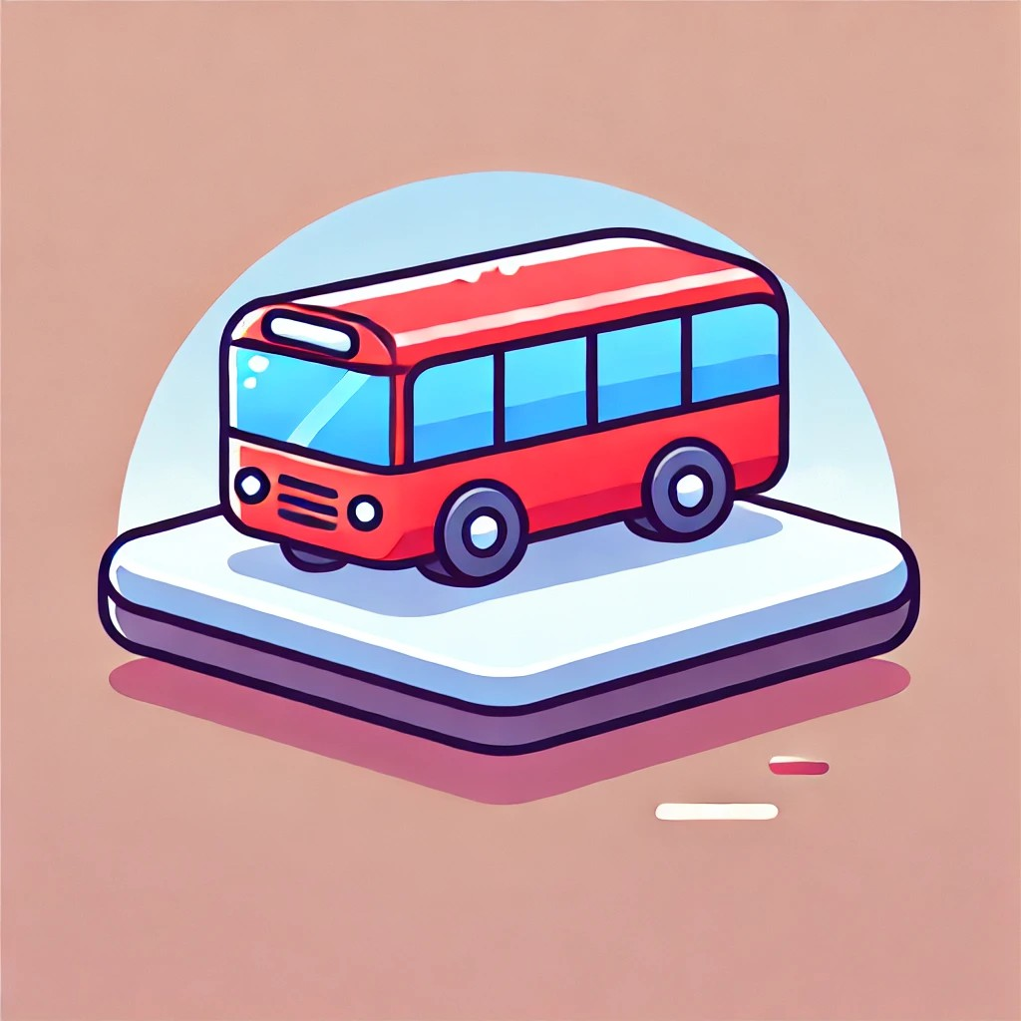
The Bus is on

Slide 65
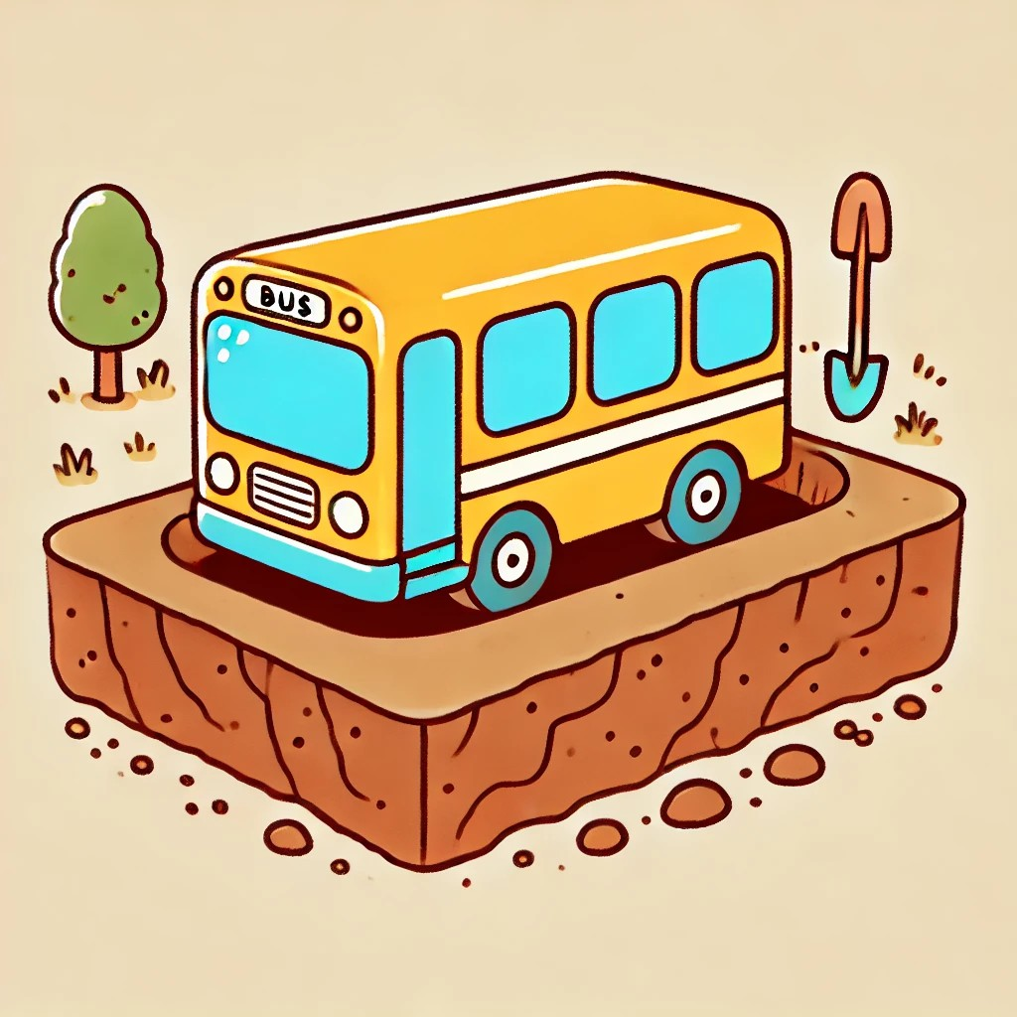
The Bus is in

Slide 66
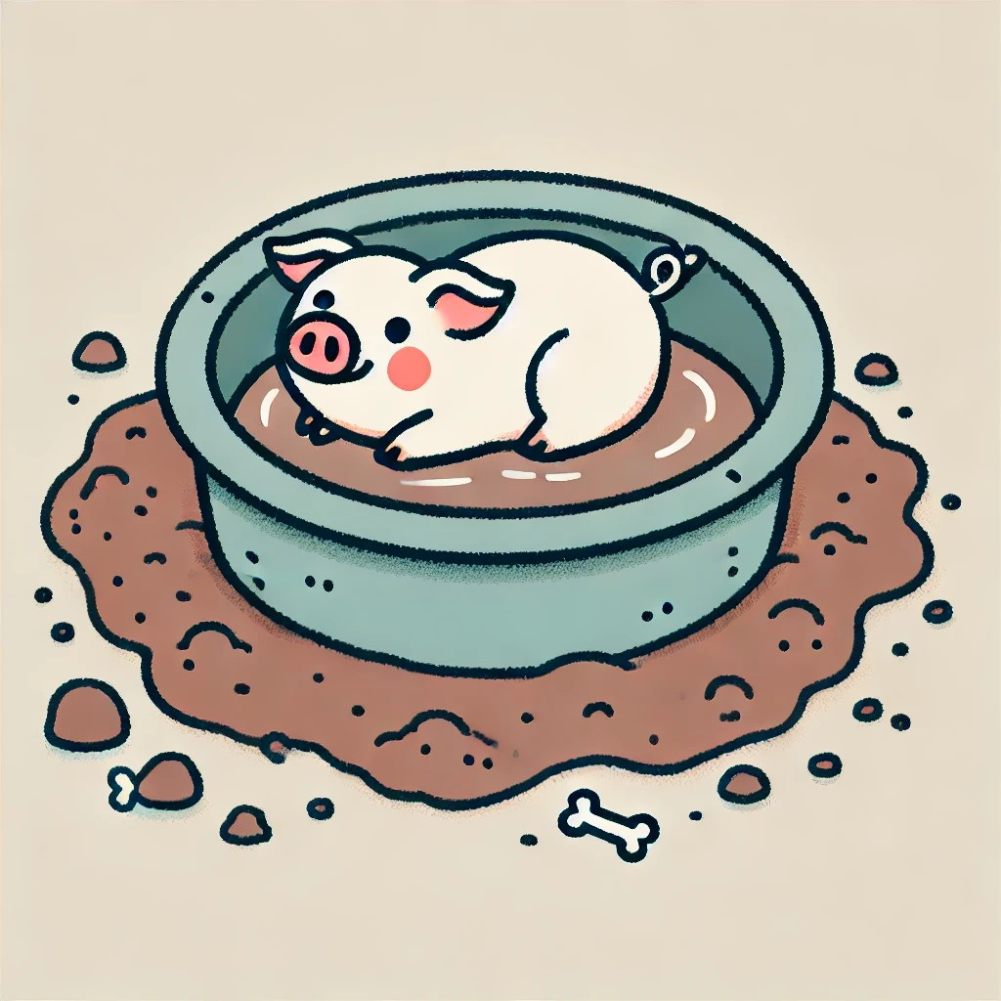
The Pig is in the Pit

Slide 67

The Pig is on

Slide 68
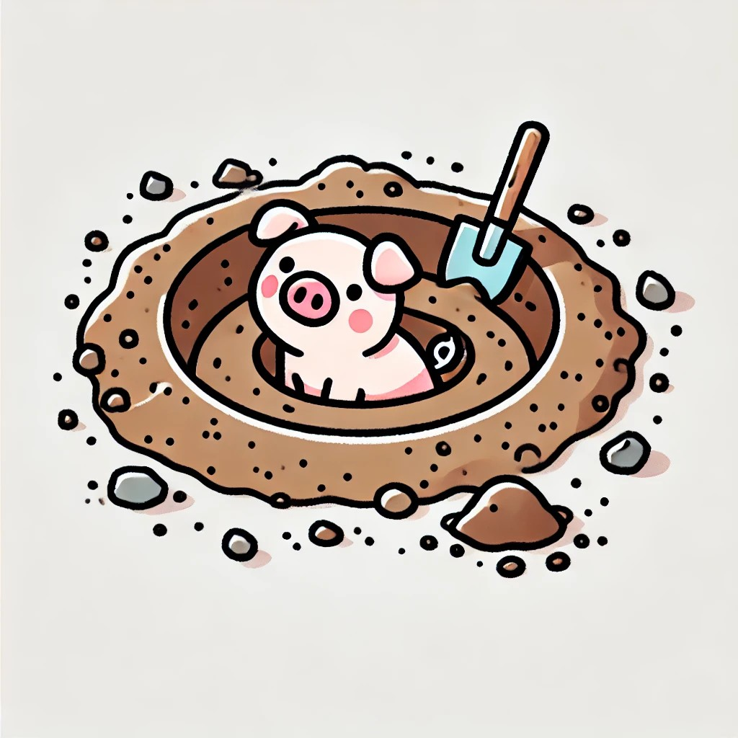
The Pig is in

